Slide 1
AMC/ MBA Preparedness for Internship Survey Survey Results

Slide 2
Executive summary
Demographics
Overall perceived preparedness
Capabilities, satisfactions and challenges
Perceived preparedness by skills group

Slide 3
Executive Summary
In 2017 the Australian Medical Council and Medical Board of Australia decided to undertake a joint survey on the topic of Preparedness for Internship. The survey, completed in September 2017, was designed to assess how well medical school prepares students for the workplace
On average respondents agreed that medical school prepared them for internship, but there was significant variance in the responses
In particular, older respondents tended to give lower scores for perceived preparedness
The survey asked questions with regard to 45 skills in eight skill groups
Areas where high ratings were given included:
Aspects of core clinical skills such as taking a history and examining patients, and patient-related skills such as communication with patients and involving patients in decisions
Other skills such as informatics, preventing cross-infection, IV cannulation, knowing one’s own limitations, and participation in multi-disciplinary teams
Areas where low ratings were given included:
Aspects of core clinical skills such as prescription of medications and IV fluids
Nutritional care, error reporting, and certain aspects of familiarity with hospital systems and self-management skills
Most respondents did not think that medical school had prepared them well for issues such as seeking support for psychological distress, bullying and harassment, or raising concerns about colleagues who were distressed or not performing
Limitations of the survey include:
A sample of respondents responded (not the whole population). Sample bias may have arisen, for example, if less satisfied students were more motivated to complete the survey

Slide 4
Executive summary
Demographics
Overall perceived preparedness
Capabilities, satisfactions and challenges
Perceived preparedness by skills group

Slide 5
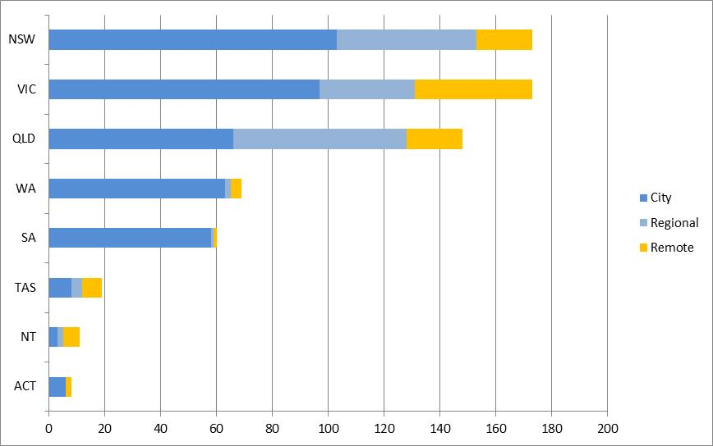
About 75% of respondents were located in NSW, VIC or QLD. 85% were in cities or regional centres
LOCATION OF RESPONDENTS UNDERTAKING SURVEY BY STATE/ TERRITORY AND REGION TYPE*
* City = state and territory capitals; Regional = Gold Coast-Tweed Heads, Newcastle-Maitland, Central Coast, Sunshine Coast, Wollongong, Geelong, Townsville, Cairns, Toowoomba; Remote = not city or regional

Slide 6
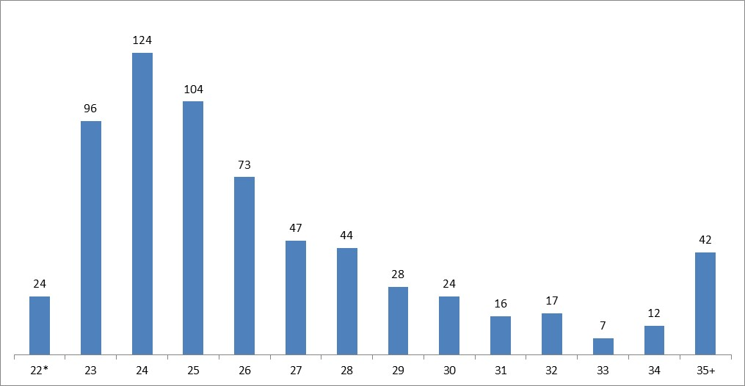
82% of respondents were in their twenties, 15% were in their thirties, 3% were forty years old or older
NUMBER OF RESPONDENTS UNDERTAKING SURVEY BY AGE
* Respondents 22 years old and younger

Slide 7
Executive summary
Demographics
Overall perceived preparedness
Capabilities, satisfactions and challenges
Perceived preparedness by skills group

Slide 8
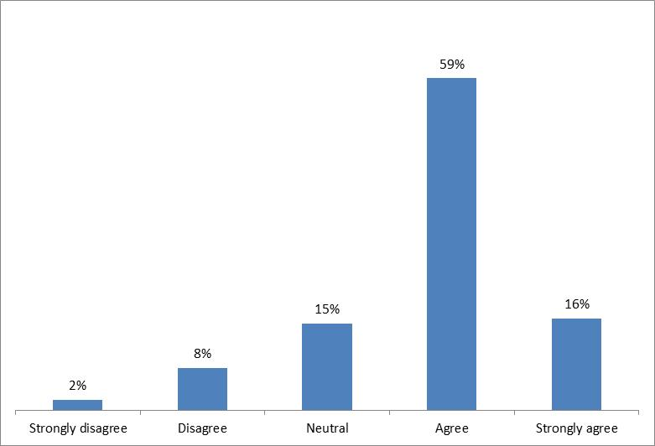
Overall respondents felt that their medical education had prepared them sufficiently for internship, but there was significant variance in responses
PERCEPTIONS OF LEVEL OF PREPAREDNESS BY RESPONDENTS
(Percentage of respondents expressing level of agreement on Five Point Likert scale*)
* In answering the following question: Please indicate your level of agreement with the statement: “Overall I felt my medical education was sufficient to undertake the role and responsibilities of intern”

Slide 9
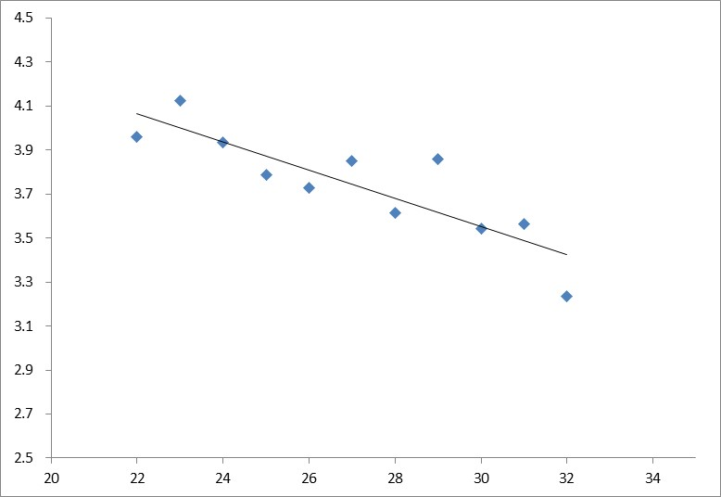
In particular, age had a significant and negative correlation with perceived preparedness
OVERALL PREPAREDNESS RATING AS A FUNCTION OF AGE
(Scatter plot of respondent age versus average Likert rating*)
Rating
(2 = disagree, 3 = neutral, 4 = agree, 5 = strongly agree*)
Age
* Likert scale responses by age of respondent in answering the following question: Please indicate your level of agreement with the statement: “Overall I felt my medical education was sufficient to undertake the role and responsibilities of intern”

Slide 10
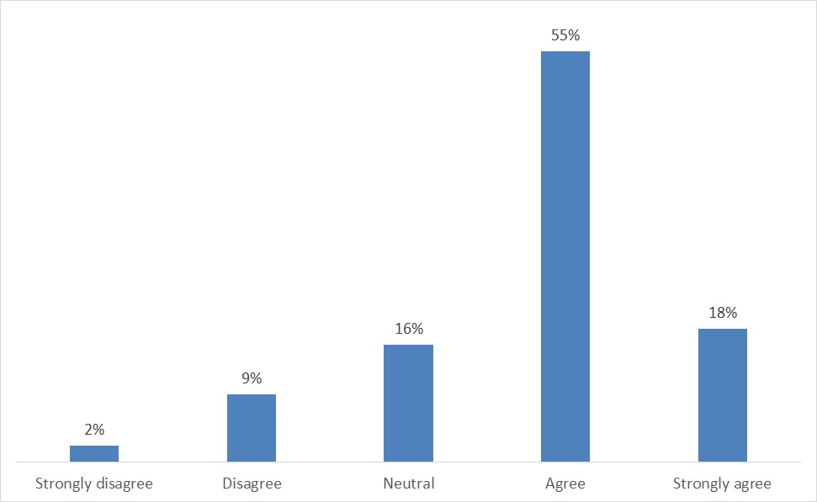
Perceptions of the adequacy of clinical experience were highly correlated with the perceptions of overall preparedness
PERCEPTIONS OF CLINICAL EXPERIENCE
(Percentage of respondents expressing level of agreement on Five Point Likert scale*)
* Proportion of respondents providing Likert scale responses answering the following questions: Please indicate your level of agreement with the statement: “I feel my clinical experience at medical school was sufficient to undertake the role and responsibilities of an intern”

Slide 11
Executive summary
Demographics
Overall perceived preparedness
Capabilities, satisfactions and challenges
Perceived preparedness by skills group

Slide 12
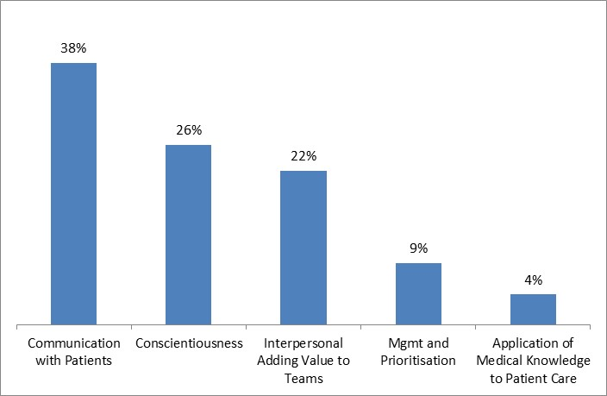
SURVEY QUESTION:
“In your view, which of the following capabilities did you bring to the job at the beginning of your internship?”
SELF-PERCEIVED CAPABILITIES
(Percentage of Respondents Nominating as Highest Ranked Option on a Five Point Forced Ranking Scale*)
* In answering the following question: In your view, which of the following capabilities did you bring to the job at the beginning of your internship? Please rank the following options from 1 most developed capability to 5 least developed capability: a) Ability to apply medical knowledge to patient care, b) Communication skills with patients, c) Interpersonal skills that could add value to teams, d) Conscientiousness enabling others to entrust me with tasks, e) Ability to prioritise and manage workload
Note: percentages may not sum to 100% due to rounding

Slide 13
SURVEY QUESTION:
Do you have other relevant capabilities not listed above?*
THEMES FROM SURVEY TEXT ANSWERS REGARDING RELEVANT CAPABILITIES FOR INTERNS
Themes | Examples
Self management | Resilience Ability to compartmentalise downfalls and setbacks
Procedural | IV cannulation Advanced life support
Patient centred | Cross-cultural skills
Teamwork | Interpersonal skills Ability to work in multi-disciplinary teams
Hospital systems | Administrative skills Hospital software, systems and processes
Managerial | Crisis management Contributions to quality improvement
* i.e. capabilities not listed in the previous question, which listed the following capabilities: a) Ability to apply medical knowledge to patient care, b) Communication skills with patients, c) Interpersonal skills that could add value to teams, d) Conscientiousness enabling others to entrust me with tasks, e) Ability to prioritise and manage workload

Slide 14
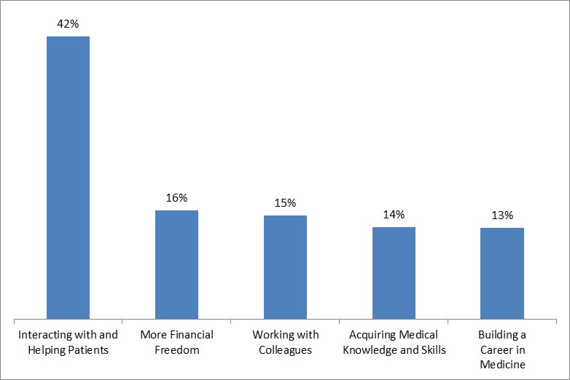
SURVEY QUESTION:
Which of the following factors most contributed to your satisfaction when you transitioned from medical school to internship?*
SOURCES OF SATISFACTION IN THE TRANSITION TO INTERNSHIP FROM MEDICAL SCHOOL
(Percentage of Respondents Nominating as First Option on a Five Point Forced Ranking Scale*)
*Text of the question as follows: Which of the following factors most contributed to your satisfaction when you transitioned from medical school to internship? Please rank the following options from 1 most satisfying to 5 least satisfying: a) Interacting with and helping patients, b) Working with colleagues, c) Acquiring additional medical knowledge and skills, d) Starting to build a career in medicine, e) Having more financial freedom
Note: percentages may not sum to 100% due to rounding

Slide 15
SURVEY QUESTION: Were there other factors not listed above?*
THEMES FROM SURVEY TEXT ANSWERS REGARDING SOURCES OF SATISFACTION FOR INTERNS
Themes | Examples
Applying knowledge | Putting learned skills into clinical practice Independence to develop clinical decision making
Teamwork | Feeling useful and valued as part of a team
Focus on work | Only having to concentrate on one job Not being required to study on a constant basis
Responsibility | An ability to solve patient problems Being responsible for other people, and for one’s own actions
* i.e. other factors than those raised in the previous question, which listed the following factors: a) Interacting with and helping patients, b) Working with colleagues, c) Acquiring additional medical knowledge and skills, d) Starting to build a career in medicine, e) Having more financial freedom

Slide 16
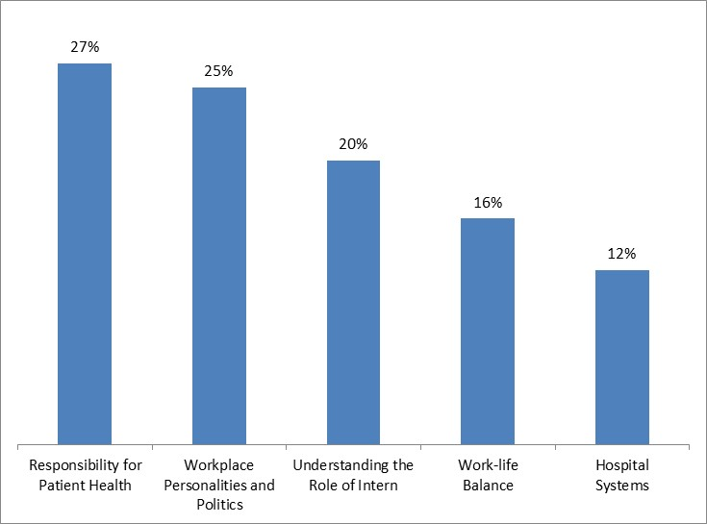
SURVEY QUESTION: Which of the following factors proved most challenging when you transitioned from medical school to internship?*
ISSUES WHICH RESPONDENTS FOUND CHALLENGING
(Percentage of Respondents Nominating as First Option on a Five Point Forced Ranking Scale*)
* Text of the question as follows: Which of the following factors proved most challenging when you transitioned from medical school to internship? Please rank the following options from 1 most challenging to 5 least challenging: a) Understanding what was required of me as an intern b) Using hospital administrative and IT systems c) Coming to terms with workplace personalities and politics d) Dealing with responsibility for patient health e) Maintaining work-life balance
Note: percentages may not sum to 100% due to rounding

Slide 17
SURVEY QUESTION: Were there other factors not listed above?*
THEMES FROM SURVEY TEXT ANSWERS REGARDING CHALLENGES IN TRANSITIONING TO INTERNSHIP
Themes | Examples
Patient responsibility | Dealing with additional responsibilities out of hours Managing patient risk
Workplace issues | Poor communication Bullying Challenging patient encounters
Management | Dealing with logistical difficulties, Knowing how to get things done
Lifestyle | Learning to ‘switch off’ Inflexible rosters
Lack of opportunity | Limited opportunities to gain skills Requirements to complete large amounts of administrative work
* i.e. other factors than those raised in the previous question, which listed the following factors: a) Understanding what was required of me as an intern b) Using hospital administrative and IT systems c) Coming to terms with workplace personalities and politics d) Dealing with responsibility for patient health e) Maintaining work-life balance

Slide 18
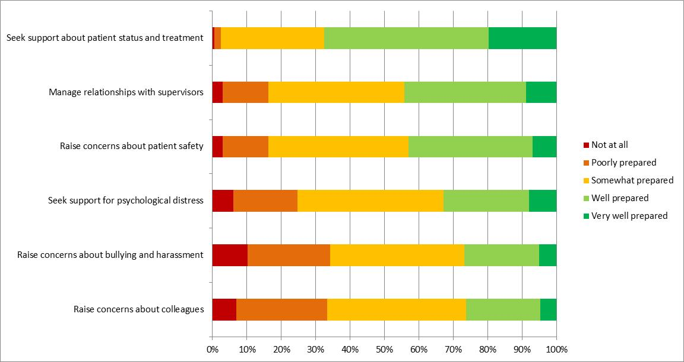
SURVEY QUESTION: Reflecting on the following issues that arise in clinical work as an intern, please indicate how prepared you feel you were to:*
PREPAREDNESS FOR SITUATIONS REQUIRING SUPPORT
(Percentage of Respondents Indicating Degree of Preparation on a Five Point Likert Scale)*
* Text of the question as follows: Reflecting on the following issues that arise in clinical work as an intern, please indicate how prepared you feel you were to: a) Seek support about patient clinical status and treatment b) Seek support for psychological distress c) Raise concerns about bullying or harassment d) Raise concerns about patient safety or perceived deficiencies in care e) Raise concerns about colleagues who are distressed or not performing f) Manage relationships with supervisors/ seniors

Slide 19
SURVEY QUESTION: If you did not feel prepared for one or more of the situations described above, please describe what would have helped you to be more prepared*:
THEMES FROM SURVEY TEXT ANSWERS REGARDING PREPAREDNESS FOR SITUATIONS REQUIRING SUPPORT
Themes | Examples
Medical education | Shift in priorities from medical knowledge and minutiae to internship preparation Information on physician burnout Training regarding bullying / harassment (possibly involving graded assertiveness)
Shadowing | Contact with JMO’s while still at medical school
Difficult to address before entering the workforce | Not necessarily a job for medical school – more a responsibility for workplace orientation and induction Management policies and escalation differ from hospital to hospital
Difficult to address because of medical professional culture | Difficulty in raising issues such as mental health and patient care as a junior team member Fear that asking for help will reflect poorly on own capabilities
* i.e. more prepared for issues raised in the previous question, which listed the following issues: a) Seek support about patient clinical status and treatment b) Seek support for psychological distress c) Raise concerns about bullying or harassment d) Raise concerns about patient safety or perceived deficiencies in care e) Raise concerns about colleagues who are distressed or not performing f) Manage relationships with supervisors/ seniors

Slide 20
Executive summary
Demographics
Overall perceived preparedness
Capabilities, satisfactions and challenges
Perceived preparedness by skills group

Slide 21
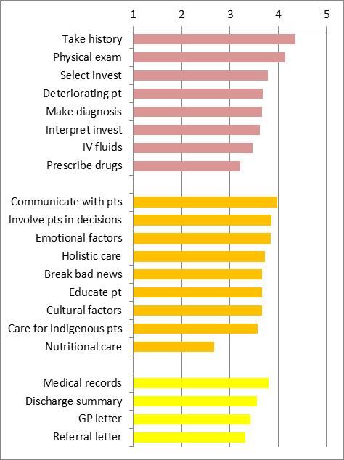
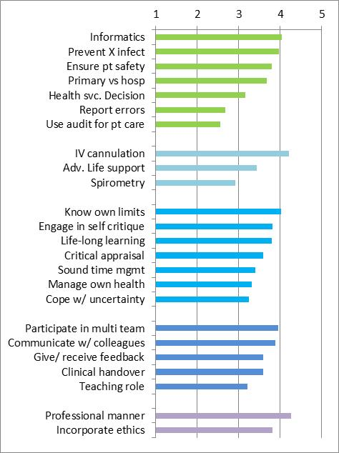
SURVEY QUESTION: Reflecting on the following issues that arise in clinical work as an intern, please indicate how prepared you feel you were to:
AVERAGE NATIONAL RATINGS FOR INTERN SKILL PREPAREDNESS (1=NOT AT ALL PREPARED, 5 = VERY WELL PREPARED)
Hospital system
Core
clinical
Procedural
Patient-centred
Self management
Team
Document
Professional
* Average of Likert scale response. See following page for more detailed skill description key

Slide 22
Key for skill profiles
KEY TO ABBREVIATIONS (FOR 45 SKILLS LISTED ON PREVIOUS PAGE)
CORE CLINICAL
Take history Taking a history
Physical exam Examining patients
Select invest Selecting appropriate investigations
Deteriorating pt Recognising a deteriorating patient
Make diagnosis Using clinical diagnosis and making a diagnosis
Interpret invest Interpreting the results of investigations
IV fluids Ordering IV fluids and blood products
Prescribe drugs Prescribing safely and calculating accurate drug dosages
PATIENT-CENTRED
Communicate with pts Communicating effectively and sensitively with patients and relatives
Involve pts in decisions Involving the patient in decision-making
Emotional factors Recognising the impact of social and emotional factors in illness and treatment
Holistic care Maintaining good quality holistic care
Break bad news Breaking bad news to patients
Educate pt Educating patients (health promotion and public health)
Cultural factors Providing appropriate care for people of different cultures
Care for Indigenous pts Providing care for Aboriginal and Torres Strait Islanders
Nutritional care Providing basic nutritional care
DOCUMENT
Medical records Keeping an accurate and relevant medical record (documenting in charts)
Discharge summary Writing a discharge summary for patients
GP letter Writing a letter to a general practitioner
Referral letter Writing a referral
HOSPITAL SYSTEM
Informatics Using informatics as a tool in medical practice (.i.e. use of Australian Medicines Handbook, therapeutic guidelines etc.)
Prevent X infect Reducing risk of cross-infection
Ensure pt safety Ensuring and promoting patient safety
Primary vs hosp Explaining the differences in the roles of primary/ social care and hospital care
Health svc. Decision Identifying the main ways that decisions are made in your health service
Report errors Reporting and dealing with error and safety incidents
Use audit for pt care Using audit to improve patient care
PROCEDURAL
IV cannulation Performing IV cannulation
Adv. Life support Taking part in advanced life support
Spirometry Performing spirometry and peak flow measurements
SELF MANAGEMENT
Know own limits Being aware of your limitations
Engage in self critique Engaging in self-critique of practice and clinical encounters
Life-long learning Engaging in self-directed lifelong learning
Critical appraisal Undertaking critical appraisal of clinical decisions and therapeutic strategies using literature, data and other evidence
Sound time mgmt. Undertaking sound time management
Manage own health Managing your own health, including stress
Cope w/ uncertainty Coping with uncertainty
TEAM
Participate in multi team Working effectively as a member of a multi-disciplinary team
Communicate w/ colleagues Communicating effectively with colleagues
Give/ receive feedback Giving and receiving feedback from colleagues
Clinical handover Providing a clinical handover
Teaching role Undertaking a teaching role
PROFESSIONAL
Professional manner Acting in a professional manner (with honesty and probity)
Incorporate ethics Incorporating ethical and legal issues into clinical situations (such as confidentiality and consent)

