Slide 1
Entrustable Professional Activity (EPA) assessor training
National Framework for Prevocational (PGY1 and PGY2) Medical Training

Slide 2
The Australian Medical Council acknowledges the Aboriginal and/or Torres Strait Islander peoples as the original people of the lands now known as Australia, and the Māori people as the tangata whenua, or original people of Aotearoa New Zealand.
We acknowledge and pay our respects to the Traditional Custodians of all the lands on which the AMC works, and their ongoing connection to the land, water and sky.
The Australian Medical Council acknowledges the past policies and practices that impact on the health and wellbeing of Aboriginal and/or Torres Strait Islander and Māori people and commit to working together with communities to support healing and positive health outcomes. The AMC is committed to improving outcomes for Aboriginal and/or Torres Strait Islander and Māori peoples.

Slide 3
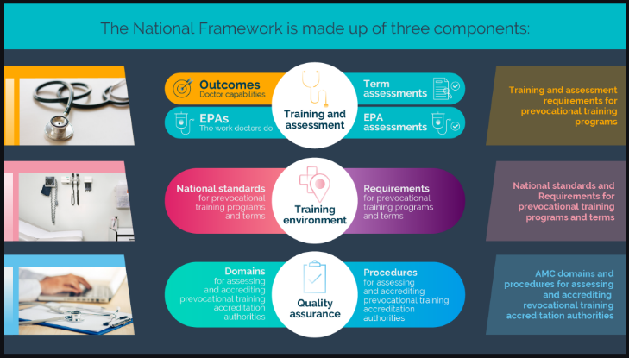
At the completion of this module: you will be trained to assess the Entrustable Professional Activities (EPAs) of prevocational doctors within the National Framework for Prevocational Medical Training.
The EPAs are part (Section 2 Part B) of the Training and Assessment component of the National Framework.

Slide 4
Learning objectives
Preparation
Activity/ observation
Feedback/ discussion
Next steps
The process:
The ‘What’?
Define what an EPA is
&
The
‘How to’?
Demonstrate the assessment of an EPA

Slide 5
Cultural safety
Across all assessments, and all Domains consistent culturally safe practice needs to be considered.
Cultural safety is determined by Aboriginal and/or Torres Strait Islander people and communities.
For all assessments, consider the appropriate person to undertake it. For example, assessments related to cultural safety should be undertaken by or with significant input from Aboriginal and/or Torres Strait Islander people.

Slide 6
Video: Introduction to the EPAs (5.30)

Slide 7
Video summary: Introduction to the EPAs
What is an EPA?
Why EPAs are beneficial to prevocational doctors?
What are the EPAs?
Examples of each EPA
How the assessment of EPAs work
How many EPA assessments have to be completed?
How do EPA assessments affect global judgements?
Who can assess performance of the EPAs?

Slide 8
Video summary: Introduction to the EPAs
EPA | Example scenario
EPA 1 Clinical Assessment | Some or all of taking a history and examining a patient and presenting a clinical summary and management plan
 | Clerking a patient in the emergency department and discussing your investigation and management plan with the registrar/consultant
 | Assessing a patient with a post-operative fever in an after-hours shift
 | Assessing a paediatric patient that has fallen off play equipment, in an emergency department setting
EPA 2 Recognition and care of the acutely unwell patient | Reporting at a clinical review on your assessment and immediate management of a patient with fever and low blood pressure the evening prior
 | Reviewing an agitated/delirious patient on ward call and discussing with the medical registrar and nursing staff about a management plan
 | Assessing a patient with acute chest pain during an after-hours “ward” call shift

Slide 9
Video summary: Introduction to the EPAs
EPA | Example scenario
EPA 3 Prescribing | Prescribing analgesics to a patient and your discussion about the medications with the patient
 | Discussing the prescribing management of a patient in fluid overload on the ward round
 | Performing a VTE risk assessment and prescribing the appropriate VTE prophylaxis
EPA 4 Team Communication | Communication with a GP on discharge of an elderly patient with complex medical and social issues
 | Discussing the care of an Aboriginal patient in a culturally safe way during handover
 | Presenting the key clinical issues of a patient during a handover
 | Handing over to the nurse in charge management plans post a ward round
 | Creating appropriate written documentation at the discharge of a patient
 | Referring a patient in a general practice setting to a psychiatrist via phone call

Slide 10
Preparation for an EPA assessment
Preparation
Activity/ observation
Feedback/ discussion
Next steps
There are three ways to initiate an EPA assessment:
Opportunistic
Prevocational doctor initiates
Supervisor/assessor initiates

Slide 11
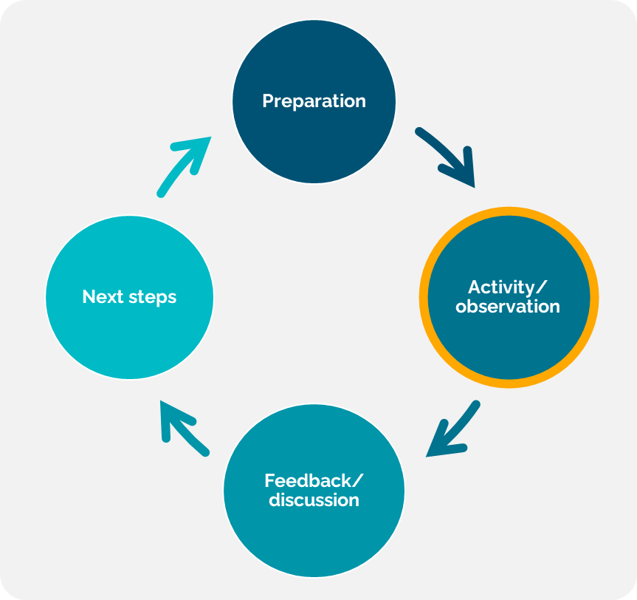
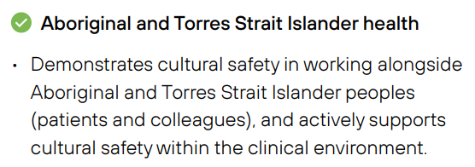
During an EPA assessment
You do not need to observe the entirety of the task described in each EPA.
You may seek input from others, including Aboriginal and/or Torres Strait Islander health professionals
Example observable behaviours in the EPAs document:

Slide 12
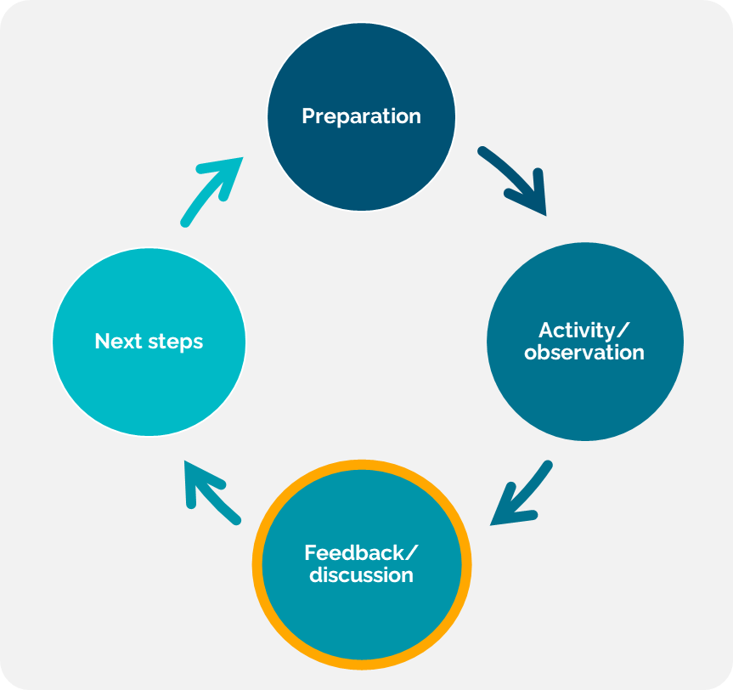
During an EPA assessment
What does an EPA assessment discussion look like?
Discussing:
the prevocational doctors’ self-assessment
strengths and areas for improvement
Agreeing on learning goals
Additional extension questions can also be included throughout the discussion

Slide 13
During an EPA assessment
Determining an entrustability rating
You already make decisions regarding the entrustability of prevocational doctors in your everyday work.
Excerpt of example completed form:

Slide 14
During an EPA assessment
Providing quality written feedback
However, greatest emphasis should be on the reflection, feedback and discussion had.
Excerpt of example completed form:
You introduced yourself appropriately to the patient and built a good rapport.
You were thorough and picked up most of the findings.
Take more time to auscultate the chest as you missed the left basal crackles.
Practice further respiratory examinations on patients during ward rounds/patient reviews and we can do another EPA on this later in the term.

Slide 15
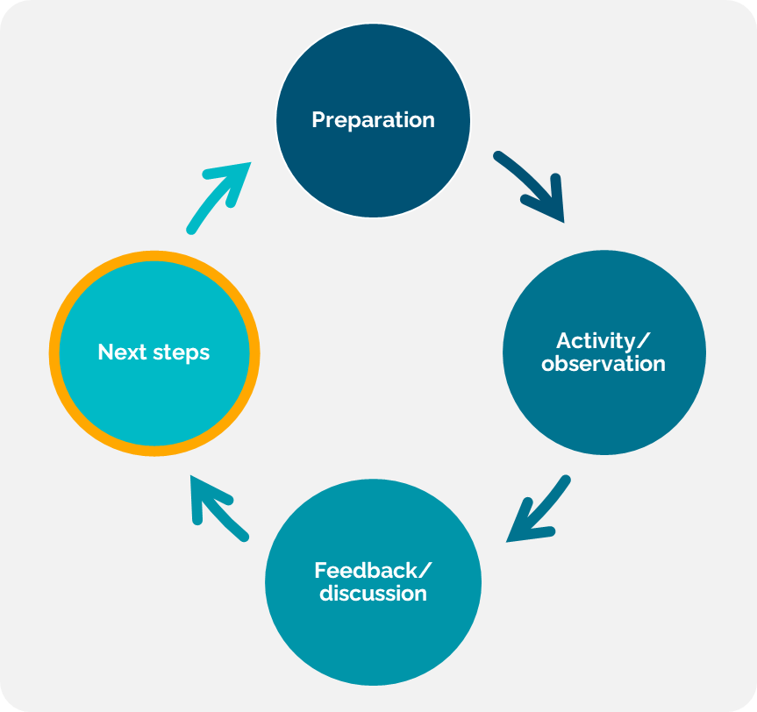
Next steps after an EPA assessment
Planning to implement learning goals
If the assessment highlighted poor performance:
Know where you can get help
Know your local escalation pathways
Self-reflection as an assessor
What might I do differently next time?

Slide 16
Case scenario 1
Placeholder for local team to choose a case scenario and embed the video here

Slide 17
Case scenario 1 - discussion
Placeholder for local team to copy-paste discussion questions from TABLE 2 in the facilitator guide or add their own.

Slide 18
Case scenario 2
Placeholder for local team to choose a case scenario and embed the video here

Slide 19
Case scenario 2 - discussion
Placeholder for local team to copy-paste discussion questions from TABLE 2 in the facilitator guide or add their own.

Slide 20
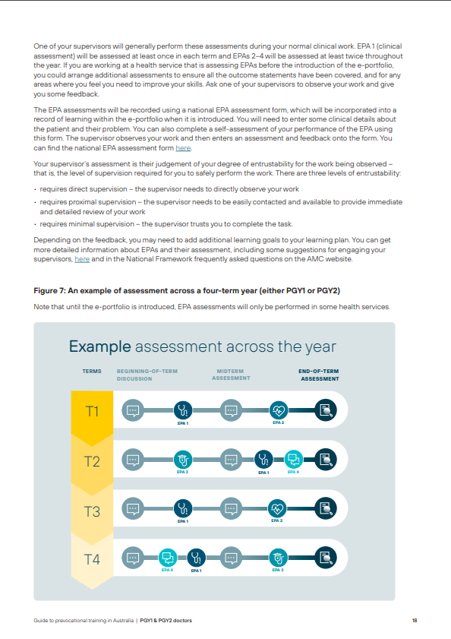
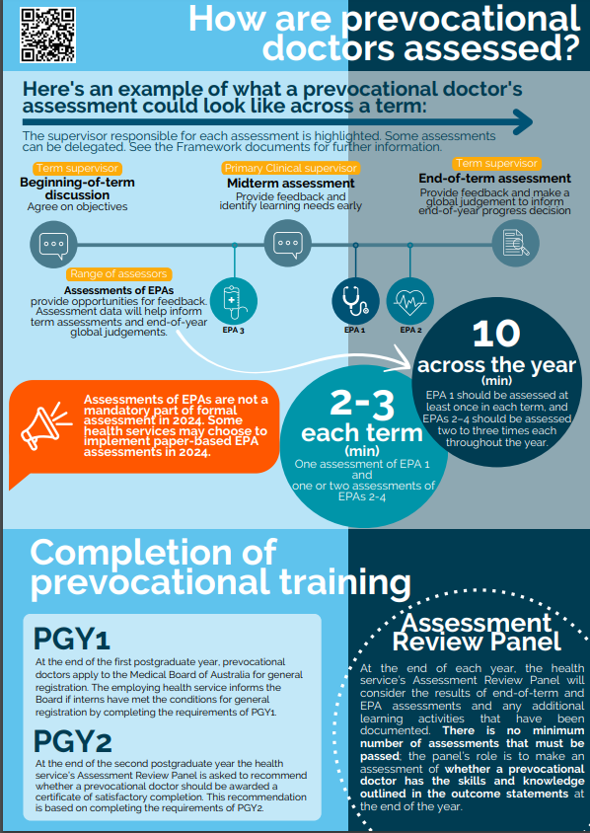
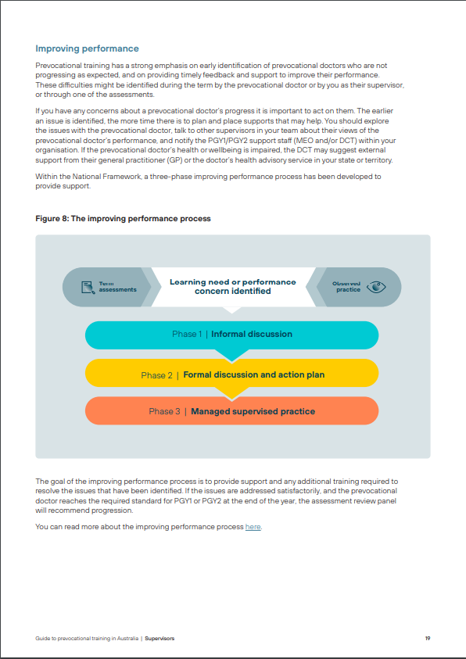
Where further information can be found
The observable behaviours and other information about the EPAs can be found in Section 2 Part B of the Training and Assessment document.
Guide to Prevocational Training in Australia (for PGY1 & PGY2 doctors/ for supervisors) and ‘at-a-glance’ flyers
Other training modules
Introduction to the EPAs video
Introduction to the National Framework video
EPA assessment forms
1.
2.
4.

Slide 21
Module end

