Slide 1
Overview:
National Framework for Prevocational (PGY1 and PGY2)Medical Training
OCTOBER 2023

Slide 2
Timelines
All Health Ministers' agreed to recommendations of 2015 COAG report including:
Two-year capability and performance framework
Entrustable professional activities
E-portfolio specifications
Review and development work including extensive stakeholder consultation:
4 formal consultation periods
Stakeholder workshops and Reference Group meetings
Speaking engagements at conferences and stakeholder meetings
The AMC was tasked to develop the 2-year framework by AHMAC (now HCEF)
The AMC commenced a review of the PGY1 Framework
2018
2019
2020
2020-22

Slide 3
Timelines
PGY2
may be implemented in either 2024 or 2025.
may be implemented across a jurisdiction at the same time or PMCs and health services may decide that some health services will implement PGY2 in 2024 and others in 2025.
Preparation for implementation
AMC developing resources and communication to support implementation
PGY1
AMC published the new 2-year National Framework
PGY1 components implemented in 2024
2022
2023
2024
2025

Slide 4
Overview of the National Framework
https://www.amc.org.au/framework
Training and assessment requirements for prevocational training programs
National standards and requirements for prevocational training programs and terms
AMC domains and procedures for assessing and accrediting prevocational training accreditation authorities

Slide 5
Revised two-year prevocational framework
Framework PGY1
Medical Board General registration
Framework PGY2
Certificate of completion of PGY2
Point of General Registration remains at satisfactory completion of PGY1
Expansion to PGY2 intended to provide better support and structure, while maintaining generalist experiences – new certificate of satisfactory completion of PGY2 (AMC?).
PGY1 and PGY2 (in prevocational framework leading to certificate) are exempt from the Medical Board of Australia's new CPD requirements
Entry into specialty training in PGY2 permitted where specialist colleges allow.

Slide 6
Key aims
STRENGTHEN ABORIGINAL AND/OR TORRES STRAIT ISLANDER HEALTH
INCREASE FOCUS ON CLINICAL WORK
ALIGN WITH COMMUNITY HEALTH NEEDS
IMPROVE SUPERVISION AND FEEDBACK
PROVIDE BROAD GENERALIST EXPERIENCES
LONGITUDINAL APPROACH
INCREASE EMPHASIS ON WELLBEING
IMPROVE NATIONAL CONSISTENCY

Slide 7
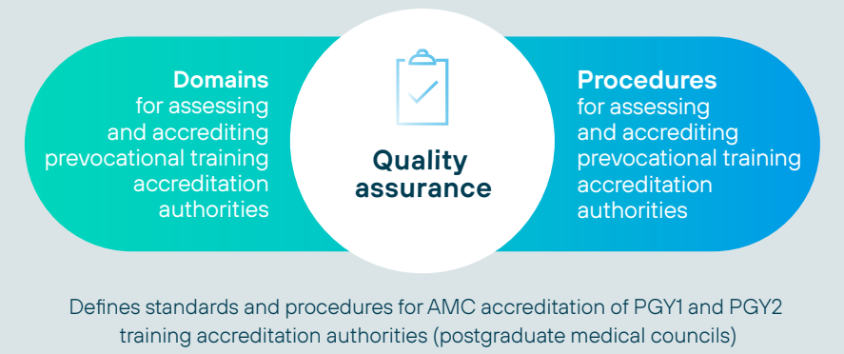
Overview of the National Framework

Slide 8
Overview:
Training and assessment

Slide 9
Training and Assessment
Supported by:
e-portfolio
Major changes
Revised outcome statements – to better reflect community health needs, incl new Aboriginal and/or Torres Strait Islander outcomes
Inclusion of EPAs – focus on clinical work, more feedback based on observed practice
Terms and EPAs mapped to outcome statements - progress against outcomes recorded in e-portfolio
- more data for end of term and end of year assessments
Global judgment at the end of the year by a panel rather than an individual

Slide 10
What is an EPA?
Entrustable Professional Activity (EPA)
An EPA is a description of work undertaken regularly in day-to-day clinical practice.
Performance of an EPA can be assessed.
In the assessment a supervisor makes a judgement about how safely the prevocational doctor can perform this piece of work – the level of entrustability.
EPAs
Describe the work doctors do

Slide 11
What are the four EPAs?
Conduct a clinical assessment of a patient incorporating history, examination, and formulation of a differential diagnosis and a management plan.
EPA1 Clinical assessment
Recognise, assess, escalate appropriately, and provide immediate management to deteriorating and acutely unwell patients. (This includes acute deterioration in mental health)
EPA2
Recognition and care of the acutely unwell patient
Appropriately prescribe therapies (drugs, fluids, blood products, inhalational therapies including oxygen) tailored to patients’ needs and conditions, either in response to a request by the treating team or self-initiated.
EPA3 Prescribing
Team communication - documentation, handover and referrals
Communicate about patient care, including accurate documentation and written and verbal information to facilitate high quality care at transition points and referral.
EPA4
https://www.amc.org.au/framework

Slide 12
Assessment of EPAs
Format:
Activity-based discussion - as part of routine clinical work.
An EPA assessment is not "pass/fail" - the supervisor makes a judgement about how safely the prevocational doctor can perform this work, the level of entrustability.
Number of EPA assessments:
Global requirements
10 minimum across the year
2 or 3 within each term
Specific requirements
EPA 1: 4 minimum across the year
EPA 2, 3 & 4: 2 minimum across the year
Assessors:
At least 1 EPA a term must be assessed by a specialist or equivalent (term supervisor).
Other EPAs in each term can be assessed by other health professionals once training in EPA assessments has been completed: e.g. specialists, registrars, nurse/ nurse practitioners, pharmacists, others as appropriate

Slide 13
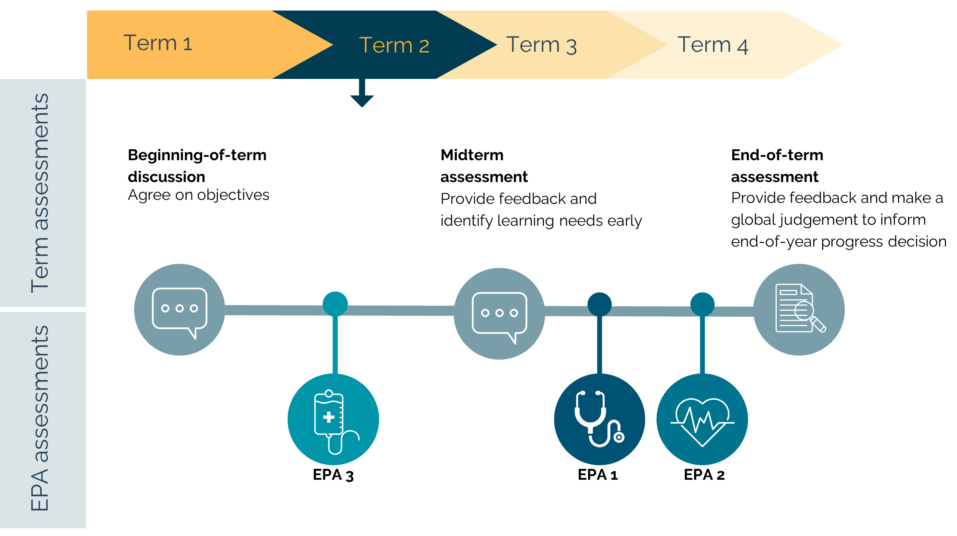
Example: Assessment within a term

Slide 14
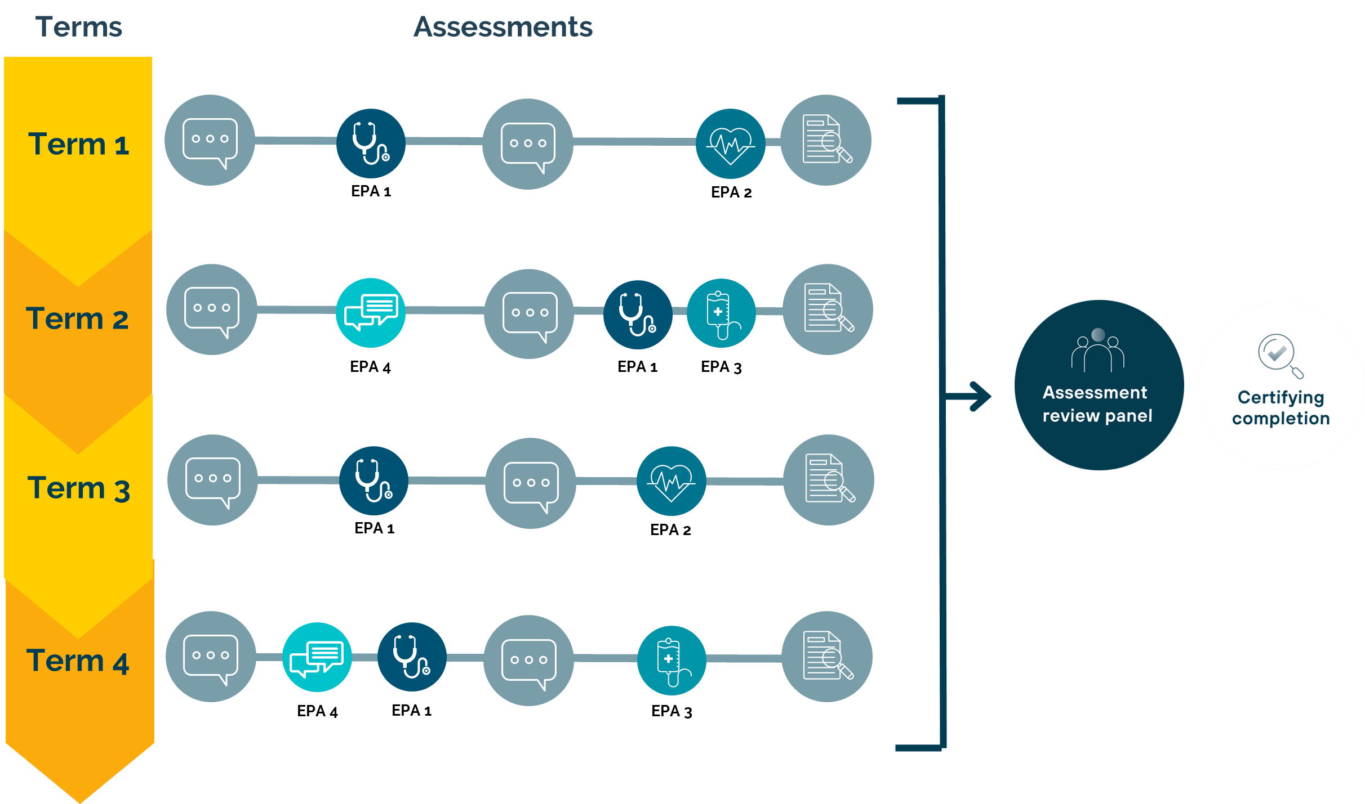
Example: Assessments across the year

Slide 15
Certifying completion
Global judgement by an assessment panel at the end of each year.
No requirement to ‘pass’ a specified number of assessments or terms.
Satisfactory performance = attainment of the required standard (prevocational outcomes) by end of year
PGY1 – Health service submits certificate of completion to the Medical Board of Australia
Process supported by:
Including:
record of learning
record of assessments
record of terms completed
PGY2 – Health service submits certificate of completion to AMC (TBC)*
e-portfolio
Evidence provided to the assessment panel to support decision making:
Program length (47 weeks)
Term requirements (revised parameters)
Achievement of prevocational outcomes:
Term assessments (mid and end)
Assessment of EPAs – optional in 2024
Other learning activities (documented in e-portfolio)

Slide 16
Overview:
Training environment

Slide 17
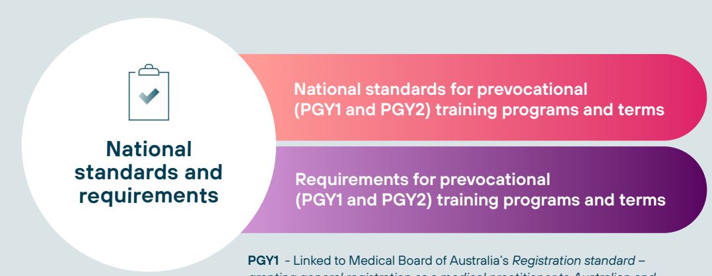
Training Environment
Used by postgraduate medical councils in accrediting training programs
Used by training providers in delivering prevocational training

Slide 18
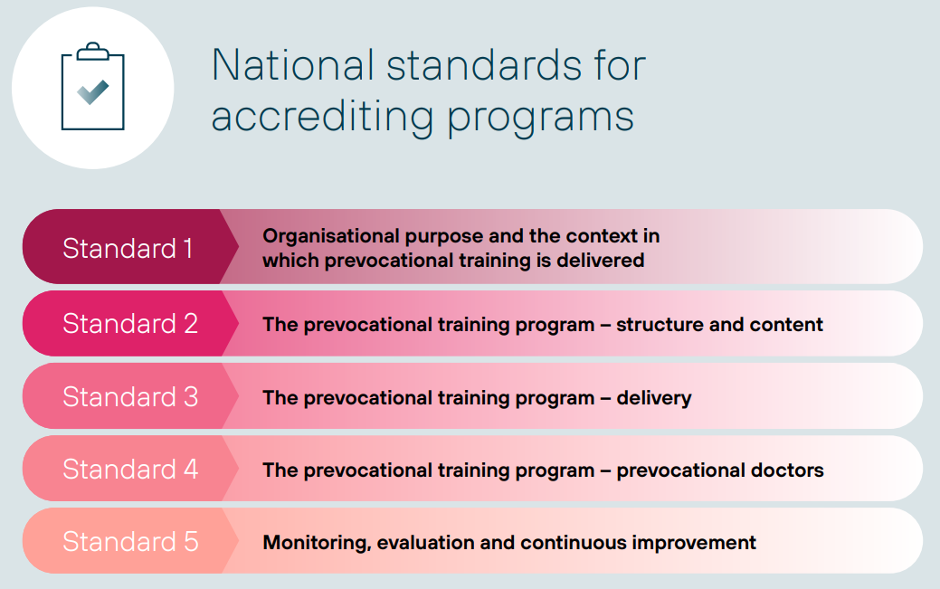
National Standards
These standards are used by postgraduate medical councils in accrediting training providers.
Major changes
Expanded to PGY2
Inclusion of new term requirements / assessment requirements (EPAs, Assessment Review Panel etc.)
Strengthened Aboriginal and Torres Strait Islander standards
Strengthened wellbeing standards
Mandated term supervisor training (within 3 years)
Mandated use of national standards
In future - Mandatory community terms

Slide 19
Requirements for programs and terms
Program level requirements
Term descriptions
 | PGY1 | PGY2
Length | Minimum 47 weeks | Minimum 47 weeks
Structure | Minimum of 4 terms (of at least 10 weeks) | Minimum of 3 terms (of at least 10 weeks)
Specialties | Maximum 50% any specialty and 25% subspecialty | Maximum 25% subspecialty in a year
Embedded in clinical teams | At least 50% of the year | At least 50% of the year
Service terms - relief and nights | Maximum 20% of the year | Maximum 25% of the year
Program content - Clinical experiences
Term descriptions must include:
the role of the prevocational doctor
the team
clinical experiences (1 or 2)
learning (prevocational) outcomes
supervisors
assessment
Focus on:
program rather than terms
breadth of experience
A. Undifferentiated illness
A. Undifferentiated illness
B. Chronic illness
B. Chronic illness
C. Acute and critical illness
C. Acute and critical illness
D. Peri-operative/ procedural

Slide 20
Example PGY1 programs
Clinical experience categories
A. Undifferentiated illness
C. Acute and critical illness
D. Peri-operative/ procedural
B. Chronic illness
Term 1
Geriatric medicine
Term 2
General Practice (rural)
Term 3
Renal
Medicine
Term 4
Acute surgical unit
Example 1
B
C
A
B
B
C
C
D
Term 1
Medical Assessment unit
Term 2
General Medicine
Term 3
Emergency Department
Term 5
Interventional
Cardiology
Example 2
Term 4
Relief
A
C
B
C
A
D
Term 1
Endocrinology
Term 2
General surgery
Term 3
Emergency Department
Term 4
Acute surgical unit
Example 3
B
C
D
A
C
C
D

Slide 21
Example PGY2 programs
Clinical experience categories
A. Undifferentiated illness
C. Acute and critical illness
B. Chronic illness
Term 1
Acute Psychiatric unit
Term 2
Emergency Department
(metro)
Term 3
Integrated General Practice/ Emergency (rural)
Example 1
B
C
A
C
A
B
Term 1
General Practice
Term 2
Intensive care unit
Term 3
Rehabilitation
Term 4
Paediatrics
Example 2
A
B
C
B
A
C
Term 1
Intensive care unit
Term 2
Emergency Department
Term 3
General surgery
Term 4
Vascular surgical unit
Example 3
Term 5
Relief
C
A
C
B
C
B
C

Slide 22
Overview:
Quality Assurance

Slide 23
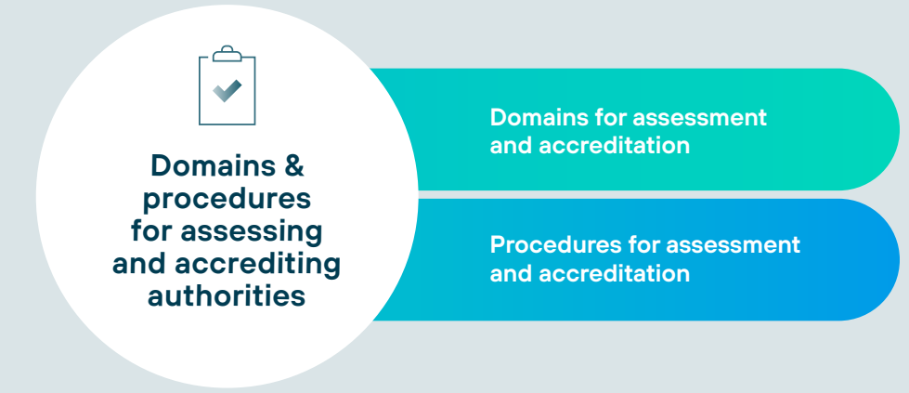
Quality Assurance
Used by AMC to accredit postgraduate medical councils

Slide 24
Domains and procedures for assessing and accrediting prevocational training accreditation authorities
Overview of domains for assessing PMCs
Domain 1
Purpose and Governance
Changes
No major changes
Included requirement to use and respond to external sources of data (e.g. the Medical Training Survey)
Domain 2
Independence
Domain 3
Operational management
Domain 4
Processes for accreditation of prevocational training programs
Domain 5
Stakeholder collaboration
Procedures for accrediting PMCs

Slide 25
Overview:
National e-portfolio

Slide 26
e-portfolio
In 2023 the AMC was advised that all jurisdictions had agreed to a national approach and to commence work on the procurement and development of a national e-portfolio.
HECF have established National e-Portfolio Project Board (NEPB) with PMCs and Health Departments represented
Procurement process occuring mid- to late-2023.
Framework supported by:
Including:
record of learning
tracking against outcomes
platform for assessments
record of assessments
reflections
ability to upload learning activities
program delivery/ administration
- reminders / record of terms completed
data collection (e.g. accreditation)
e-portfolio

Slide 27
Overview:
Preparing for implementation

Slide 28
Resources to support implementation
www.amc.org.au/framework
FREQUENTLY ASKED QUESTIONS
EXAMPLE PGY1 AND PGY2 PROGRAMS
WRITTEN GUIDE FOR PGY1 & PGY2 DOCTORS
+ SUMMARY FLYER
WRITTEN GUIDE FOR SUPERVISORS
+ SUMMARY FLYER
TEMPLATES:
BEGINNING OF TERM DISCUSSION
TERM DESCRIPTION
GUIDANCE RESOURCE:
ABORIGINAL AND/OR TORRES STRAIT ISLANDER HEALTH AND CULTURAL SAFETY CONTENT*
WRITTEN GUIDE FOR ASSESSMENT REVIEW PANELS
VIDEO RESOURCES
*to be published

Slide 29
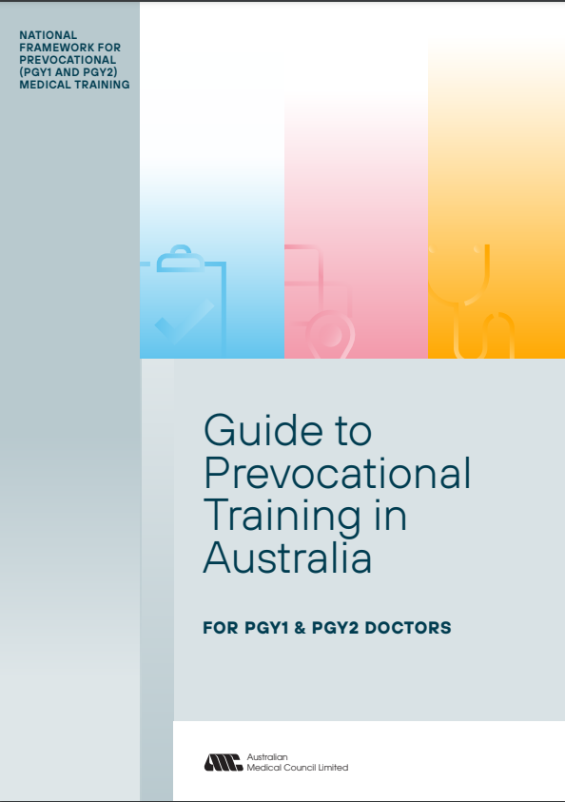
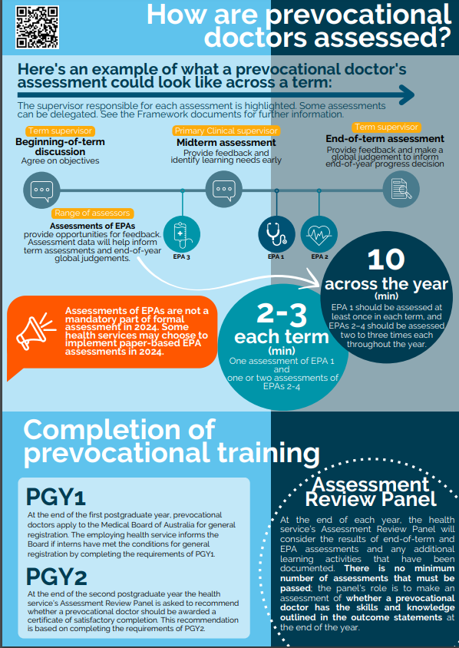
Resources to support implementation
Written Guide for PGY1 & PGY2 Doctors
+ Summary Flyer
Written Guide for Supervisors
+ Summary Flyer
Written Guide for Assessment Review Panels

Slide 30
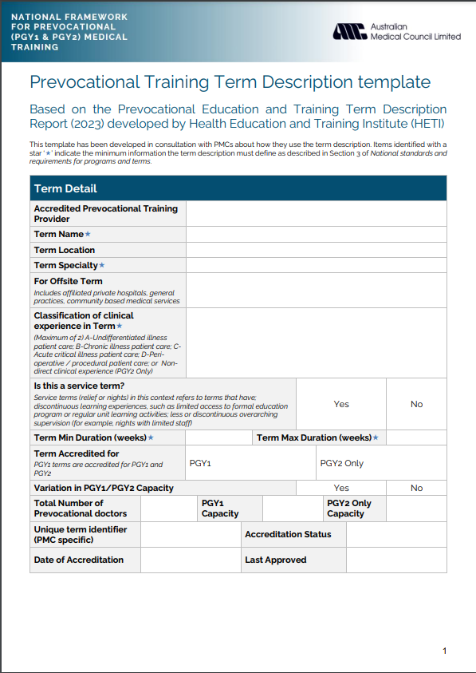
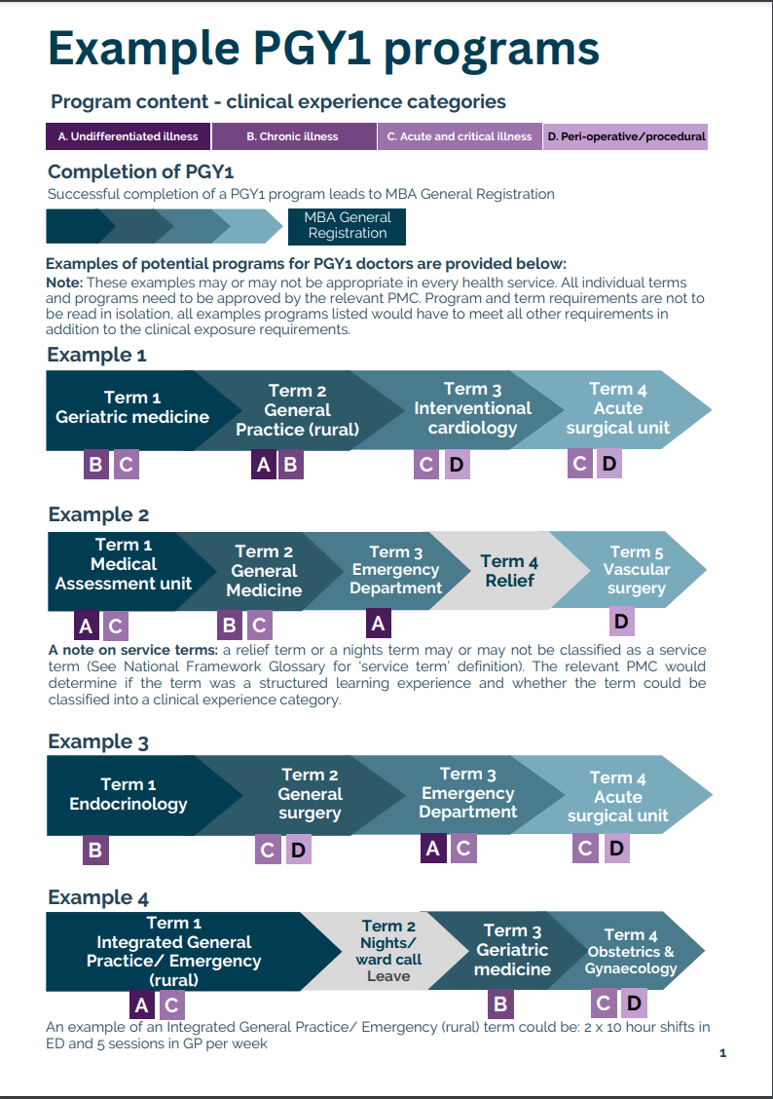
Resources to support implementation
Term description template
PMCs currently updating term descriptions for existing terms – including clinical experience categories.
Example PGY1 & PGY2 programs
Provides examples of programs and flexibility within National Framework

Slide 31
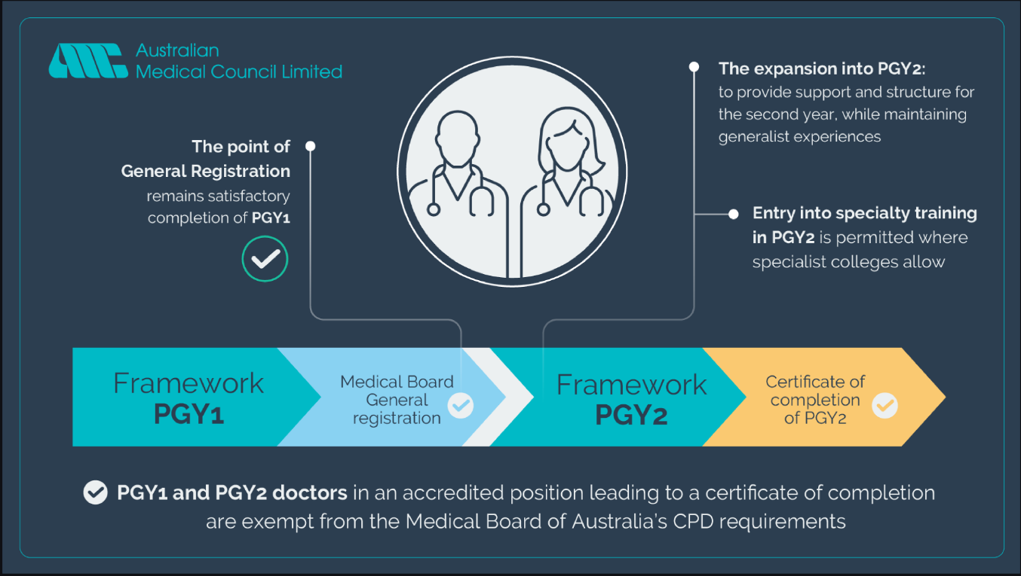
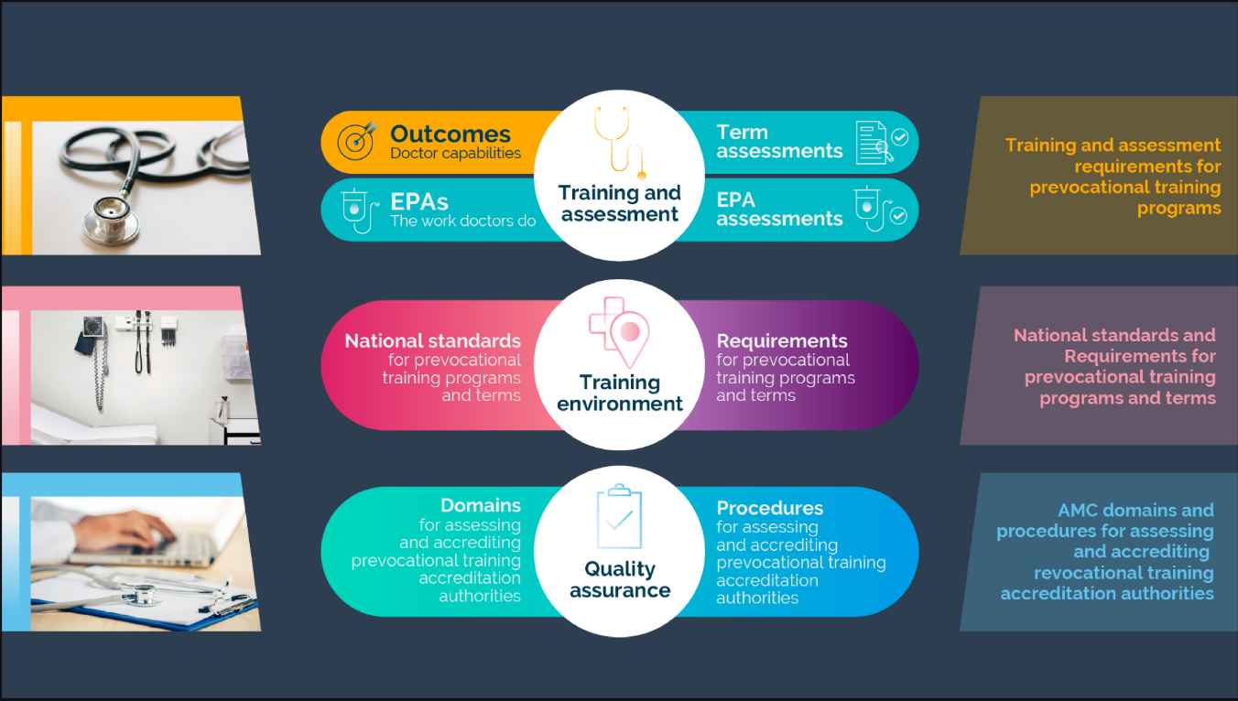
Resources to support implementation
Video: Introduction to the Framework
To be utilised in supervisor training
Used by prevocational doctors and medical students to familiarise themselves with the Framework.

Slide 32
Resources to support implementation
Video: Introduction to the EPAs
To be utilised in supervisor training
Used by prevocational doctors and medical students to familiarise themselves with the assessment format.

Slide 33
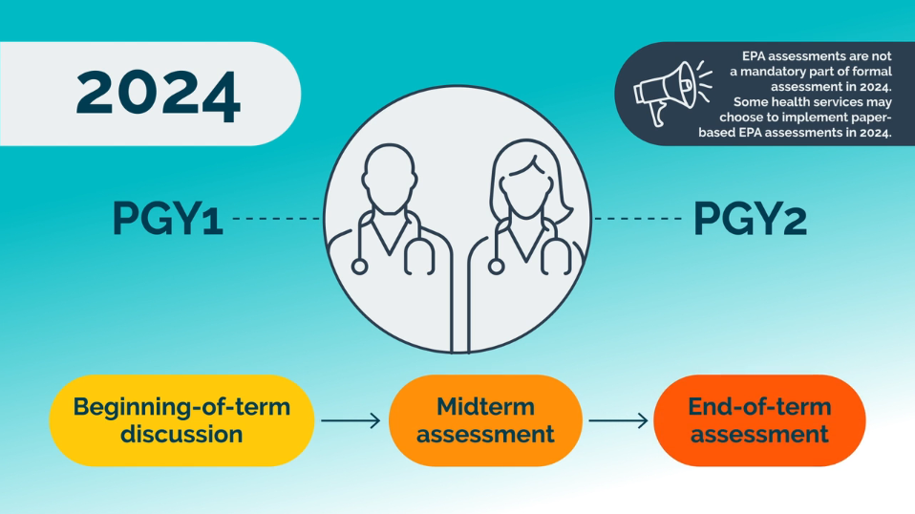
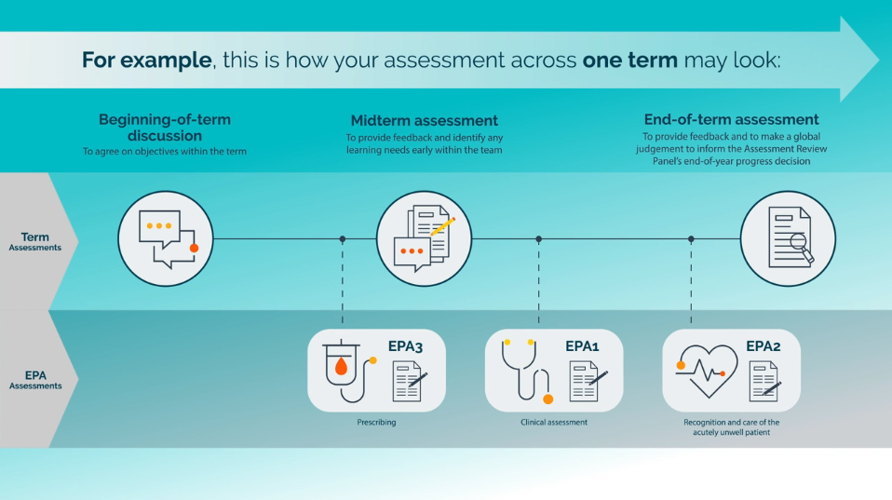
Resources to support implementation
Video: Assessment in 2024
Short snippet to clarify assessment requirements for 2024 (prior to implementation of an e-portfolio)

Slide 34
Questions?

